Slide 1
STICH CABG
Medical Therapy with or without CABG Surgery in Patients with Ischemic Cardiomyopathy: Results of the STICH Trial
Objective
To determine whether surgery plus medical management or medical management alone improve outcomes in CABG patients
Study Design
1212 patients with an ejection fraction ≤35% and CAD disease amenable to CABG were randomly assigned to medical therapy alone (n=602) or medical therapy plus CABG (n=610)

Slide 2
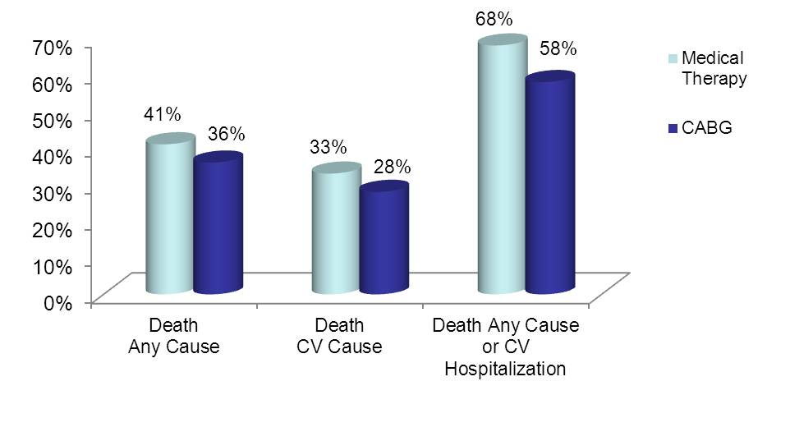
STICH CABG
Outcomes
Primary outcome was the rate of death from any cause
Secondary outcomes: Rates of CV death, death from any cause or hospitalization for CV causes
p<0.001
Results
p=0.12
p=0.05

Slide 3
STICH CABG
Conclusions
These findings suggest that assessment of myocardial viability does not provide incremental independent information in identifying patients with coronary artery disease and LV dysfunction who will have the greatest survival benefit from adding CABG
Assessment of myocardial viability should not be the sole deciding factor in selecting the best therapy for patients in this population
Study Limitations
Lack of randomization for viability testing
Small number of patients
Small proportion of patients who were judged not to have substantial viability

